Slide 1
BUS BOOKING SYSTEM
PRESENTED BY
Lido Charles
22pmc136

Slide 2


content
ABSTRACT OF BUS BOOKING SYSTEM
REQUIREMENTS
FEATURES OF BUS BOOKING SYSTEM
TECHNICAL ASPECTS
*ARCHITECTURE FOR BUS BOOKING SYSTEM
*CLASS DIAGRAM
CHALLENGES FACED
SCREENSHOOTS
FUTURE ENHANCEMENT
CONCLUSION
REFERENCES

Slide 3
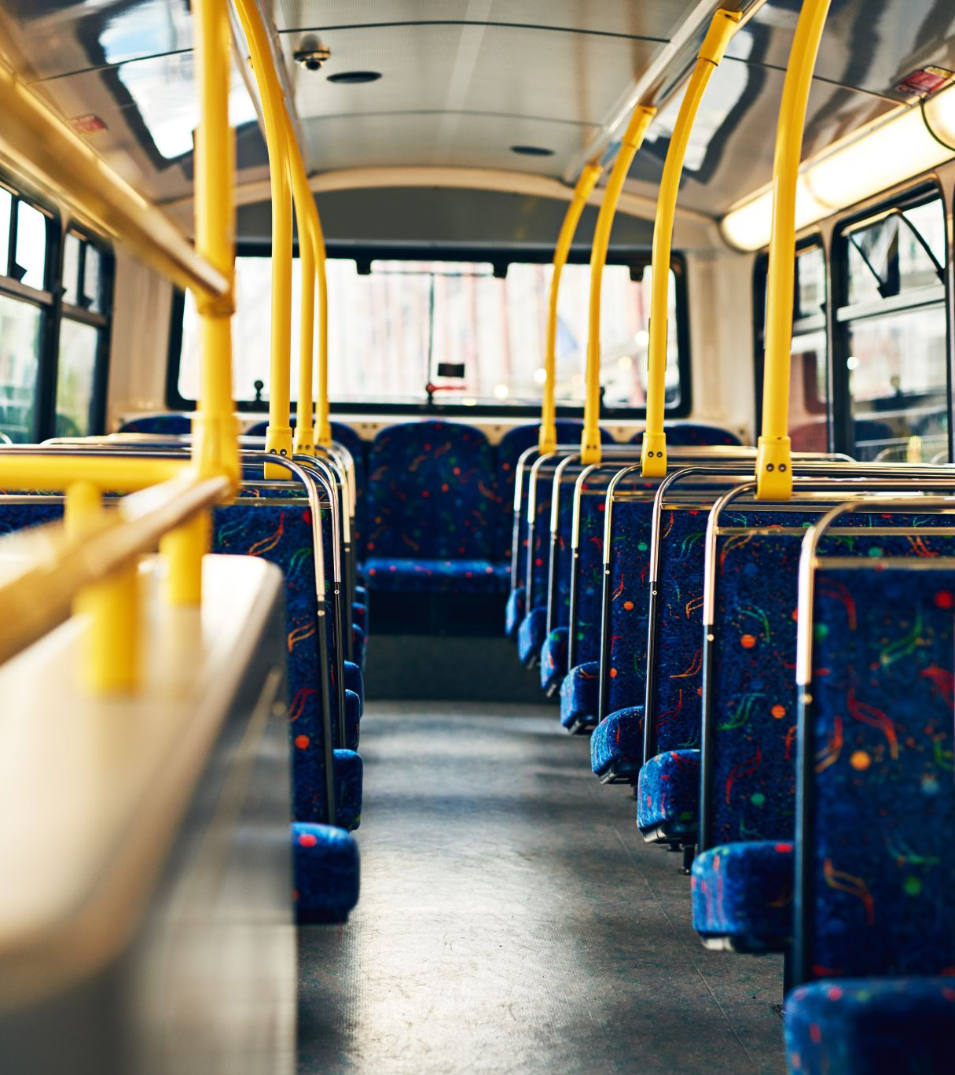
ABSTRACT OF BUS BOOKING SYSTEM
The Bus Booking System is a web application developed using the Django framework. It is designed to facilitate the process of booking bus tickets online. The system allows users to search for bus routes, view available buses, and make booking for their desired travel dates.
The system consists of several modules that work together to provide a seamless booking experience. These modules include user authentication, bus management, booking management, and payment processing.
Overall, the Bus Booking System provides a convenient and user-friendly platform for users to book bus tickets online. It streamlines the booking process, reduces manual effort, and improves the efficiency of bus ticket reservations.

Slide 4

REQUIREMENTS
User registration and login
Bus Management
Booking Management:
Online payment
Ticket cancellation
User Profile

Slide 5
FEATURES
User registration : This feature allows new users to create an account on the bus reservation system by filling in their personal information such as username, first name, last name, email, phone number, and password. After successful registration, users can log in to the system to access the bus booking and other related services.
User login: This feature allows users who have already registered with the system to log in using their credentials, such as username and password.
Seat Booking:This feature allows users to enter passenger details and book the seats on the bus and confirm their booking.
Make payment :This feature enables users to make payment for their bookings.
Ticket cancellation:This feature allows users to cancel their bookings if they have a change of plans or for any other reason.
Update User Profile and Password :This feature enables users to update their personal information and change their login password. Users can modify their name, phone number, and other details as per their requirements.
Search Bus:This feature enables users to search for buses based on various criteria such as departure location, destination and travel date.
List of Bus:This feature provides a comprehensive list of available buses that match the search criteria entered by the user. Users can view the bus details such as bus name, fare, available seats,and travel time.

Slide 6
TECHNICAL ASPECTS
ARCHITECTURE FOR BUS BOOKING SYSTEM
Presentation Layer (Frontend):
HTML/CSS: Responsible for the user interface and styling.
JavaScript: Handles interactivity and client-side validation.
Application Layer (Backend):
Web Server: Receives HTTP requests and routes them to the appropriate components.
Authentication and Authorization: Manages user authentication and authorization for secure access to the system.
Business Logic: Implements the core functionalities of the bus booking system.
API: Defines endpoints to expose functionalities for frontend and external integrations.
Database Layer:
Database Management System (DBMS): Stores and manages the system's data. Relational Database (SQLite): Handles structured data related to users, bookings, buses, etc.
Programming Language : Python
Web Framework: Django (backend)
Frontend Framework : HTML, CSS, JavaScript
Database:SQLite (supported by Django)
Third Party Libraries : Django allauth , Jazzmin

Slide 7
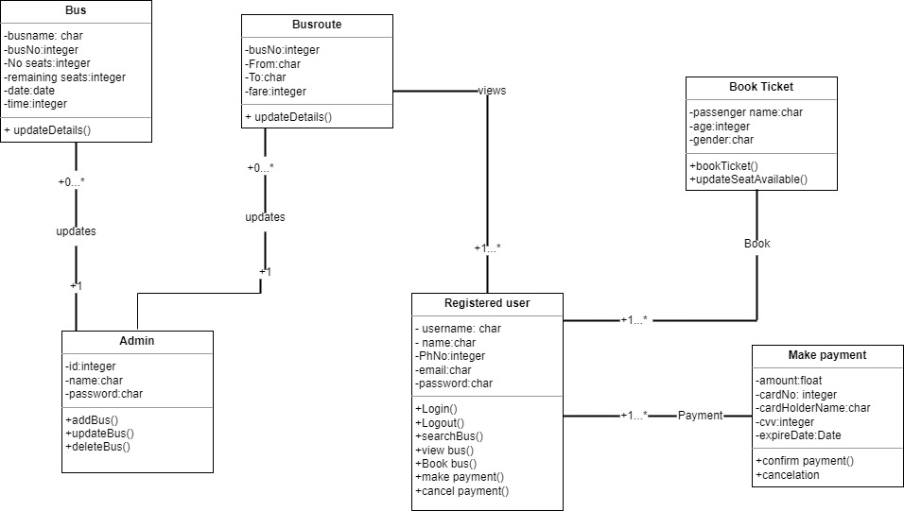
CLASS DIAGRAM

Slide 8
CHALLENGES FACED
User Authentication and Security
Designing User Interface
Validation Mechanisms
Database Design and Management

Slide 9
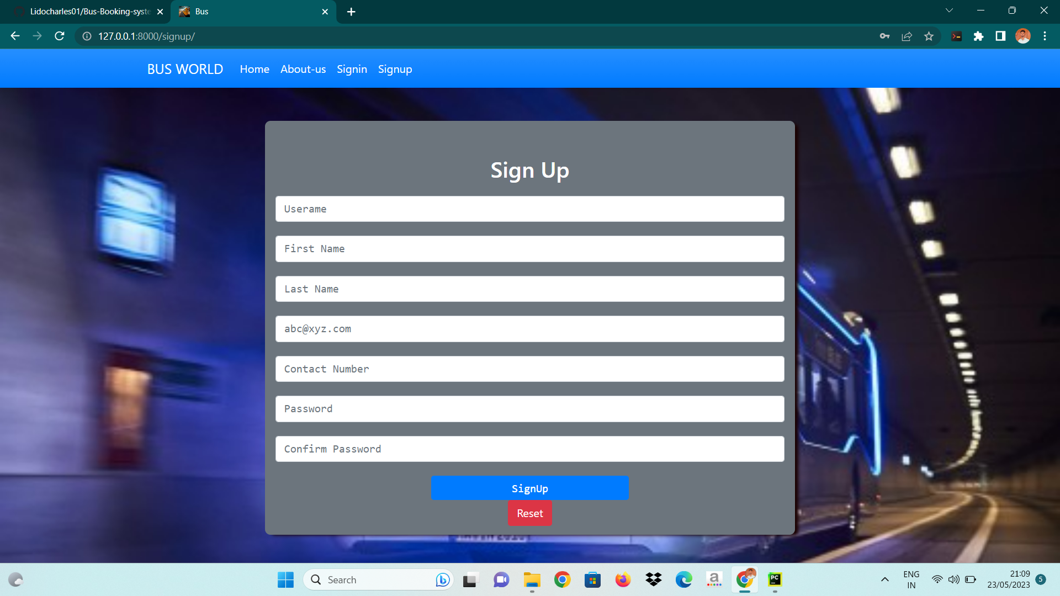
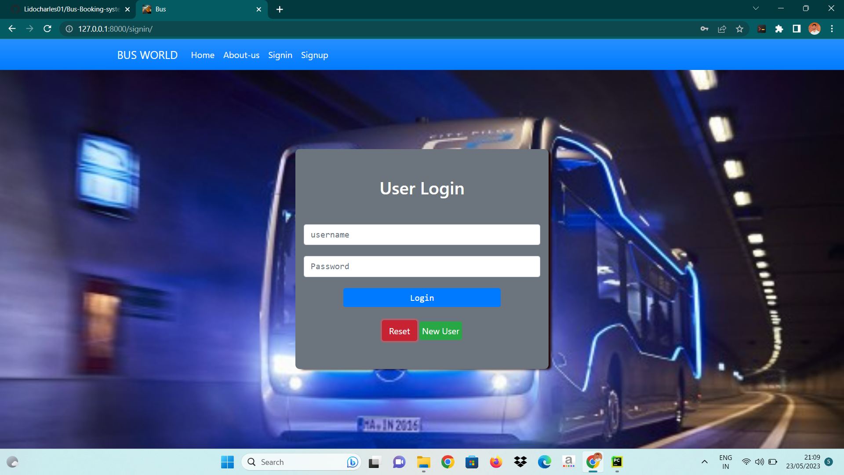
SCREENSHOOTS
User registration : This feature allows new users to create an account on the bus reservation system by filling in their personal information such as username, first name, last name, email, phone number, and password. After successful registration, users can log in to the system to access the bus booking and other related services.
User login: This feature allows users who have already registered with the system to log in using their credentials, such as username and password.

Slide 10
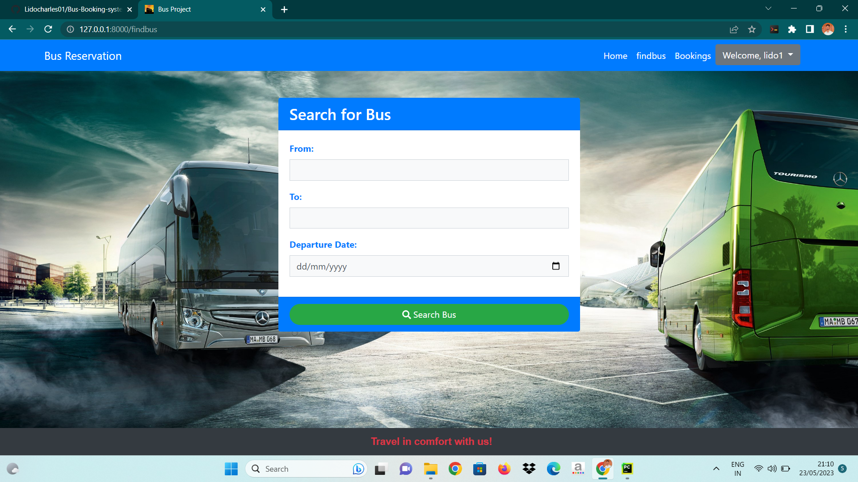
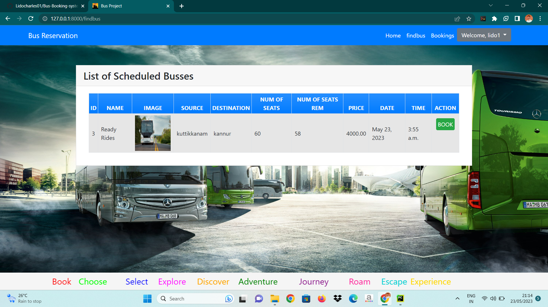
SEARCH BUS search for buses based on various criteria such as departure location, destination and travel date
LIST OF BUS
This feature provides a comprehensive list of available buses that match the search criteria entered by the user. Users can view the bus details such as bus name, fare, available seats, and travel time.

Slide 11
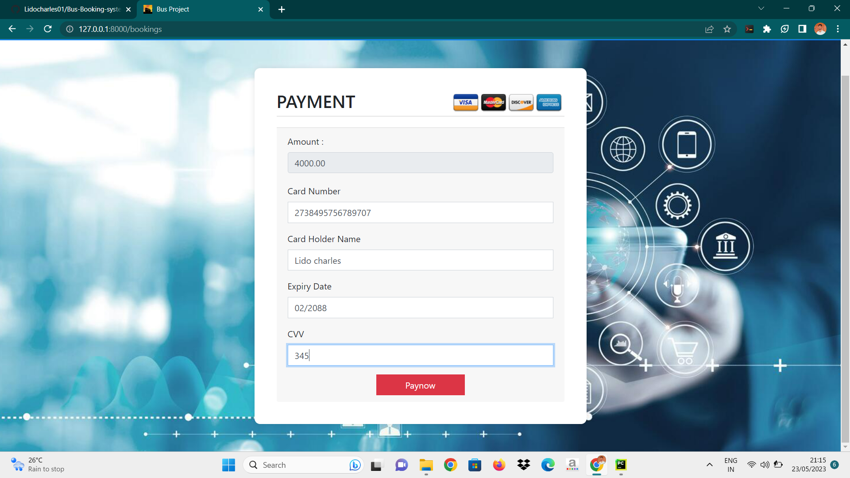
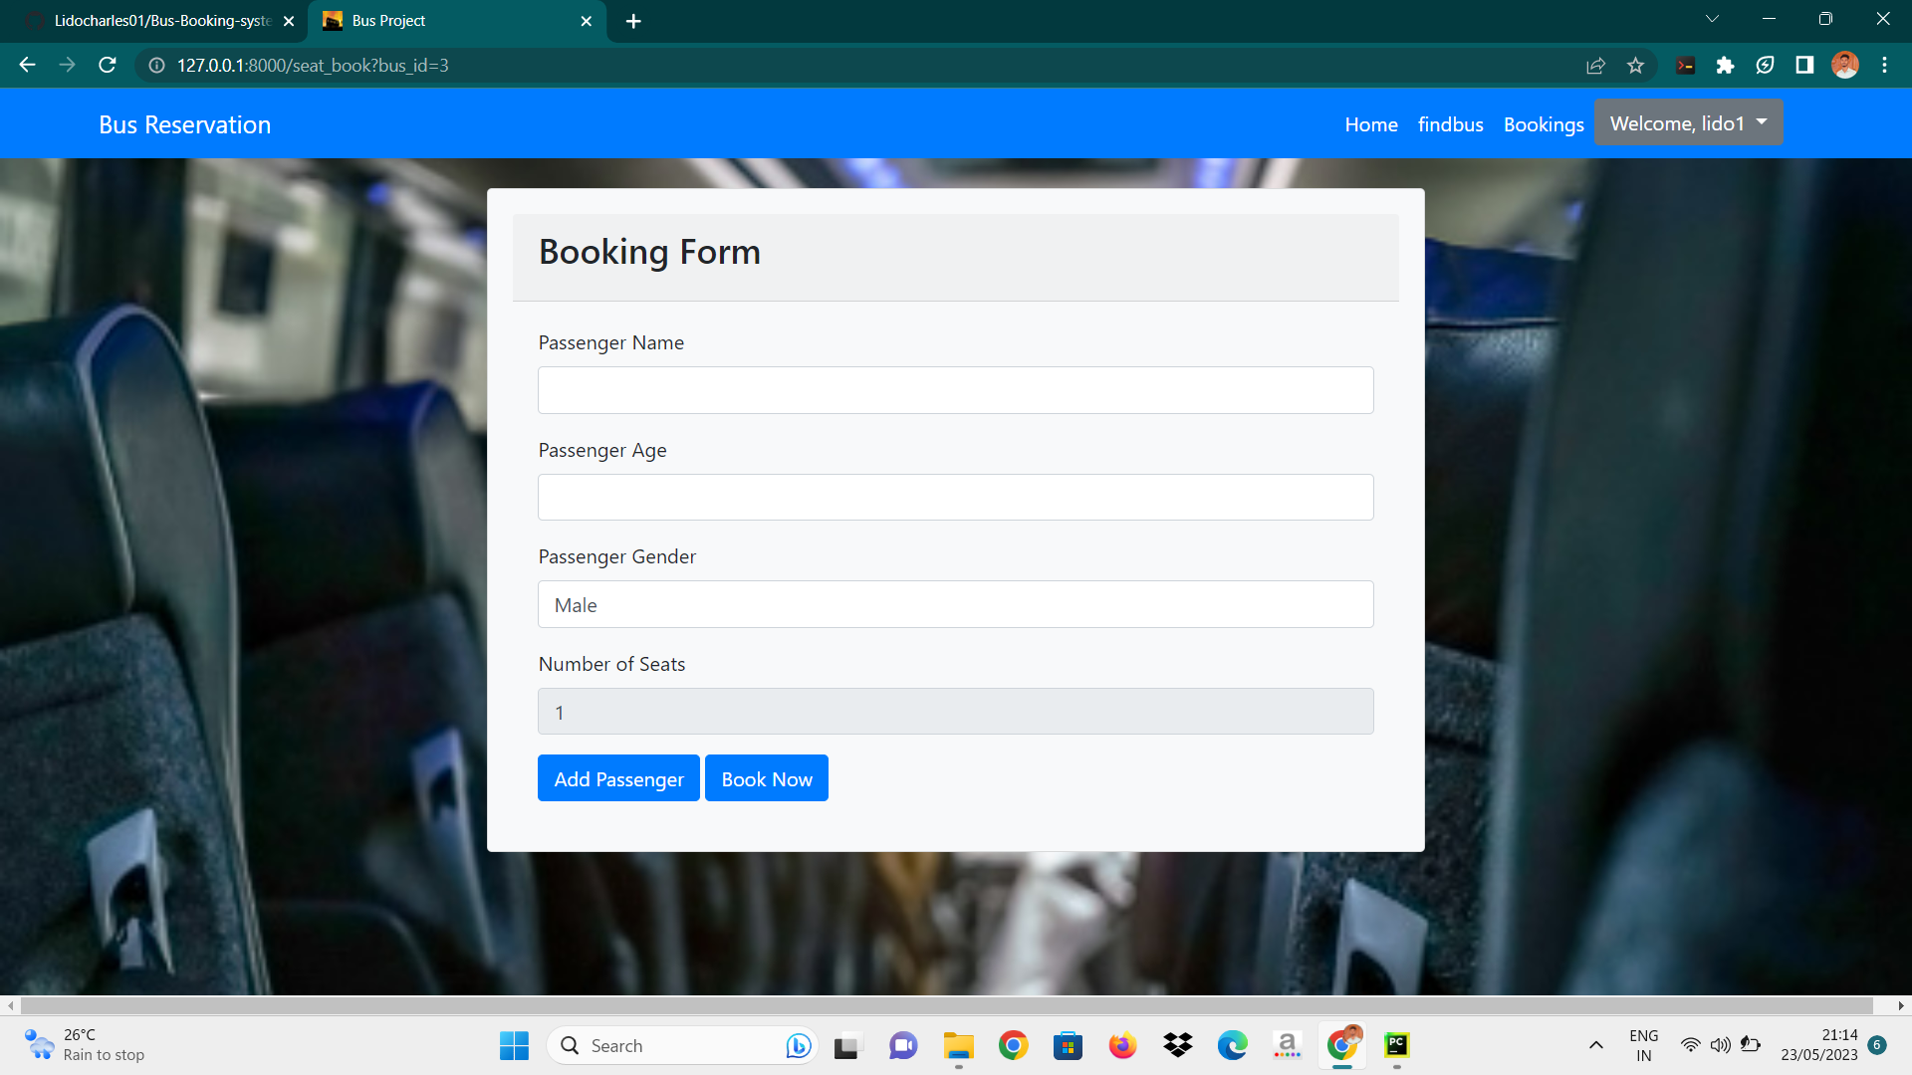
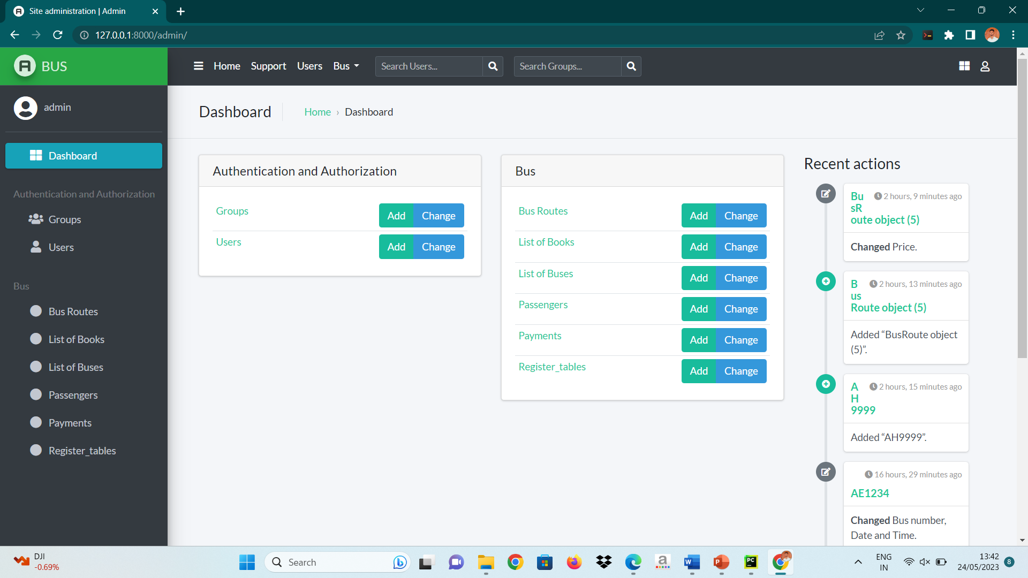
BOOK SEAT
This feature allows users to enter passenger details and book the seats on the bus and confirm their booking.
PAYMENT This feature enables users to make payment
for their bookings.
ADMIN PAGE
Admin can add bus and bus routes also manage all the activities of bus booking system

Slide 12
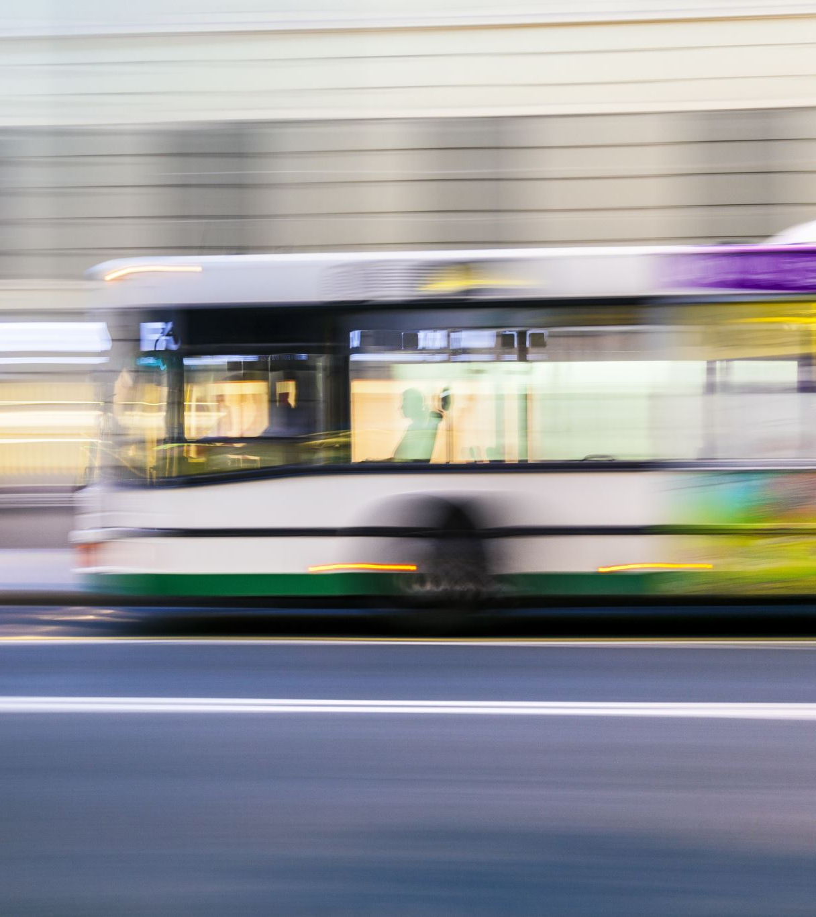
FUTURE ENHANCEMENT
In the future, bus booking systems can be enhanced in several ways to provide a more efficient and user-friendly experience. Here are some potential future enhancements:
Seamless Integration: Bus booking systems can be integrated with other modes of transportation, such as trains, flights, and taxis, to offer users a comprehensive travel solution. This integration would enable travelers to plan and book their entire journey seamlessly through a single platform.
Real-Time Updates: Implementing real-time updates regarding bus schedules, delays, and cancellations would greatly benefit passengers. Users can receive notifications through mobile apps or email, allowing them to stay informed about any changes in their travel plans.
Advanced Seat Selection: Future bus booking systems could provide more advanced seat selection options. Passengers may be able to view a detailed bus layout, indicating the availability of specific seats, their features (e.g., extra legroom, charging ports), and even offer virtual tours of the bus interior.
Enhanced Payment Options: Future systems can offer a wider range of payment options, including digital wallets, cryptocurrencies, and contactless payments. This flexibility would cater to diverse user preferences and provide a hassle-free payment experience

Slide 13

CONCLUSION
The proposed bus booking system aims to automate all fundamental operations, providing users with a convenient way to book bus tickets. The system addresses key issues present in the current system, ensuring simplicity and security in the ticket-buying process. The user registration module is an integral part of the proposed system, allowing registered users to access and purchase tickets for any bus route. To ensure privacy, the user's information will be kept confidential. This website strives to enhance user experience by consolidating resources and providing information in a convenient, impressive, and appealing manner.
User using the system can conveniently view and monitor their bookings at any time when selecting bus tickets online. The system provides a wide selection of bus routes that are available from anywhere in the world. Ordering bus tickets online has become more convenient, ensuring enhanced privacy for users.

Slide 14

REFERENCES
https://youtu.be/rHux0gMZ3Eg
https://youtube.com/playlist?list=PL1JrLEBAapUU-TG7gb8L10GChSFWxCyMP
https://youtube.com/playlist?list=PL-51WBLyFTg2vW-_6XBoUpE7vpmoR3ztO
https://docs.djangoproject.com/en/4.1/intro/tutorial01/

Slide 15
THANK YOU

